Slide 1

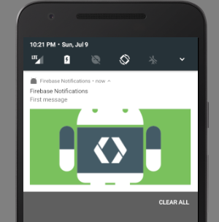

Notifications with images using firebase

Slide 2

the image url for our example is
https://pbs.twimg.com/profile_images/606585229034135553/2NqZJYQI_400x400.png

Slide 3
we can use images as specific key inside of our notification
imageURL = remoteMessage.getData().get("image_url");
Log.d("FirebaseNofifications", "Notification url: " + imageURL);
Add images in our push notifications
Bitmap bitmap = getBitmapfromUrl(imageURL); notification.setStyle(new NotificationCompat.BigPictureStyle().bigPicture(bitmap));

Slide 4
Method to download image from URL
public Bitmap getBitmapfromUrl(String imageUrl) { try { URL url = new URL(imageUrl); HttpURLConnection connection = (HttpURLConnection) url.openConnection(); connection.setDoInput(true); connection.connect(); InputStream input = connection.getInputStream(); Bitmap bitmap = BitmapFactory.decodeStream(input); return bitmap; } catch (Exception e) { e.printStackTrace(); return null; } }

